Slide 1


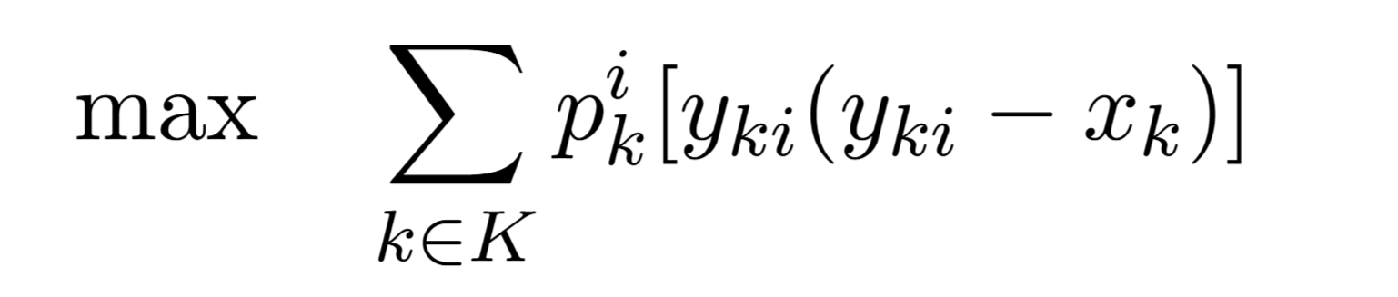
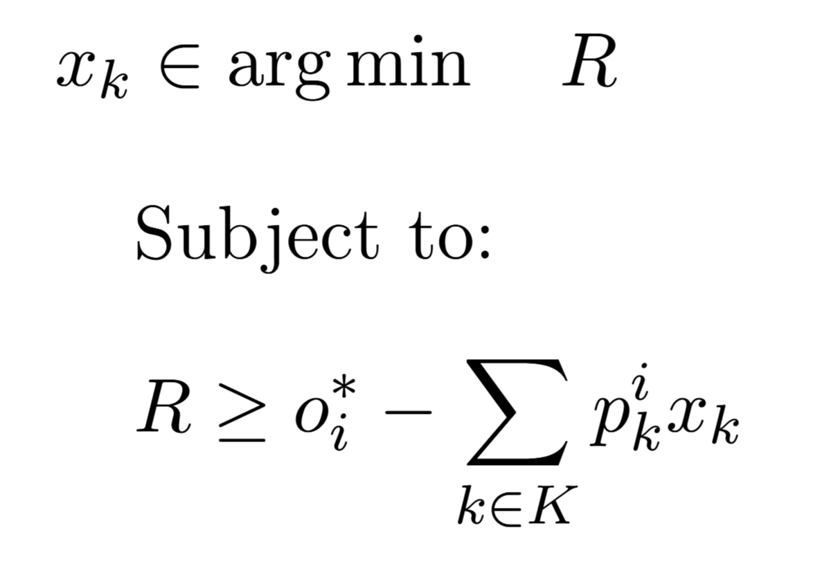
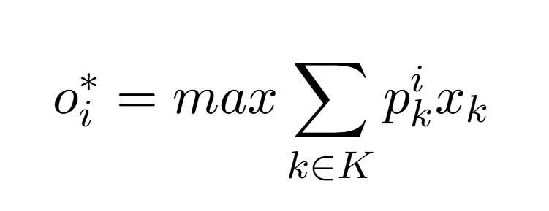
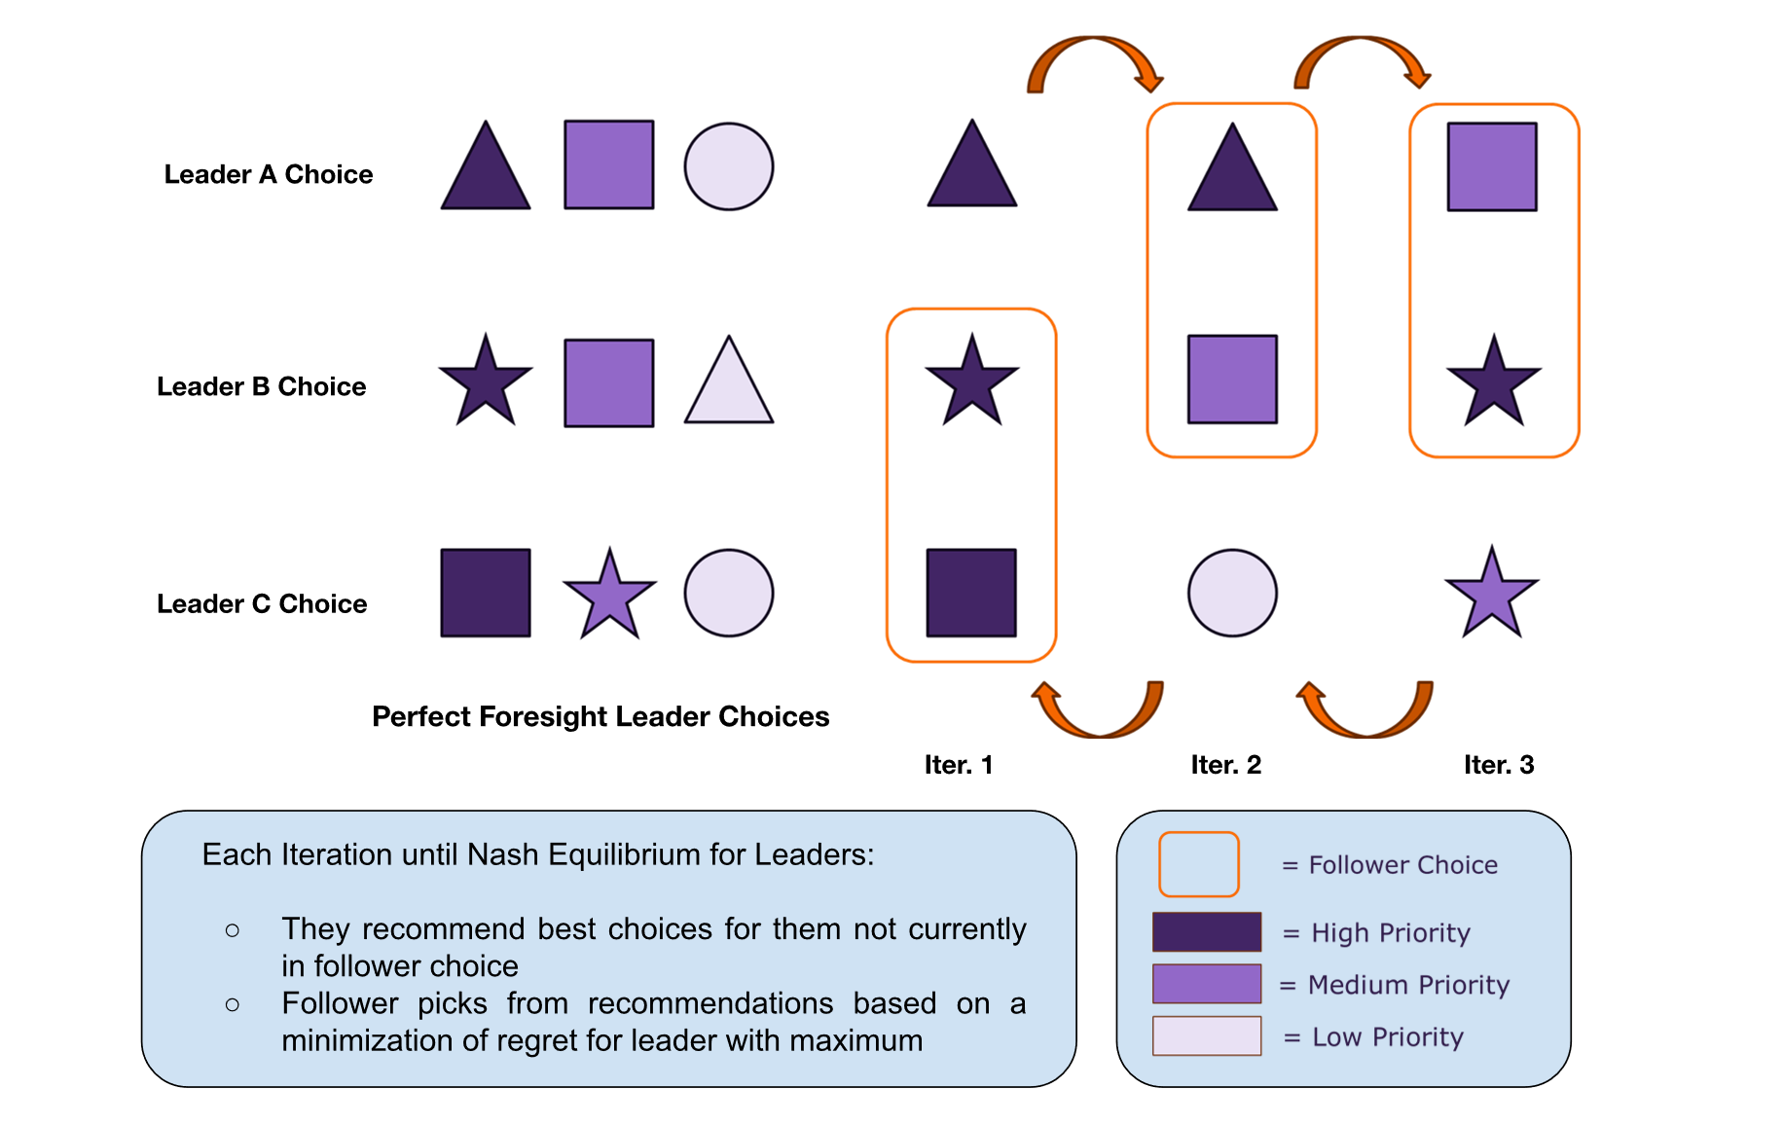

Methods for Modeling Regret of Parameterization Choices
Gabriel L. Griffin¹, Anabel Fletcher², Dakota Nobuyuki Goto³, Martha Lucia Sabogal De La Pava, Melika Jahan Beikloo, David White, Emily L. Tucker
University of Oklahoma, Smith College, Fordham University, Clemson University
Stackelberg Game Bilevel Optimization
Leaders defined by indexes making choices on which items not chosen by follower are most important to them
Follower makes item choices based on minimization of maximum regret faced by any leader
Introduction
Conclusion
Sample
Methods
Analysis
Representation of Bi-Level Stackelberg Game for Mini-Max Regret
Results
References
Acknowledgements
A large thank you to Dr. Thomas Sharkey, Dr. Jessica Aviles, and Clemson Industrial Engineering for their support during this project
This material is based upon work supported by the National Science Foundation under Grant Number 2348774. Any opinions, findings, and conclusions or recommendations expressed in this material are those of the author(s) and do not necessarily reflect the views of the National Science Foundation.

